Slide 1

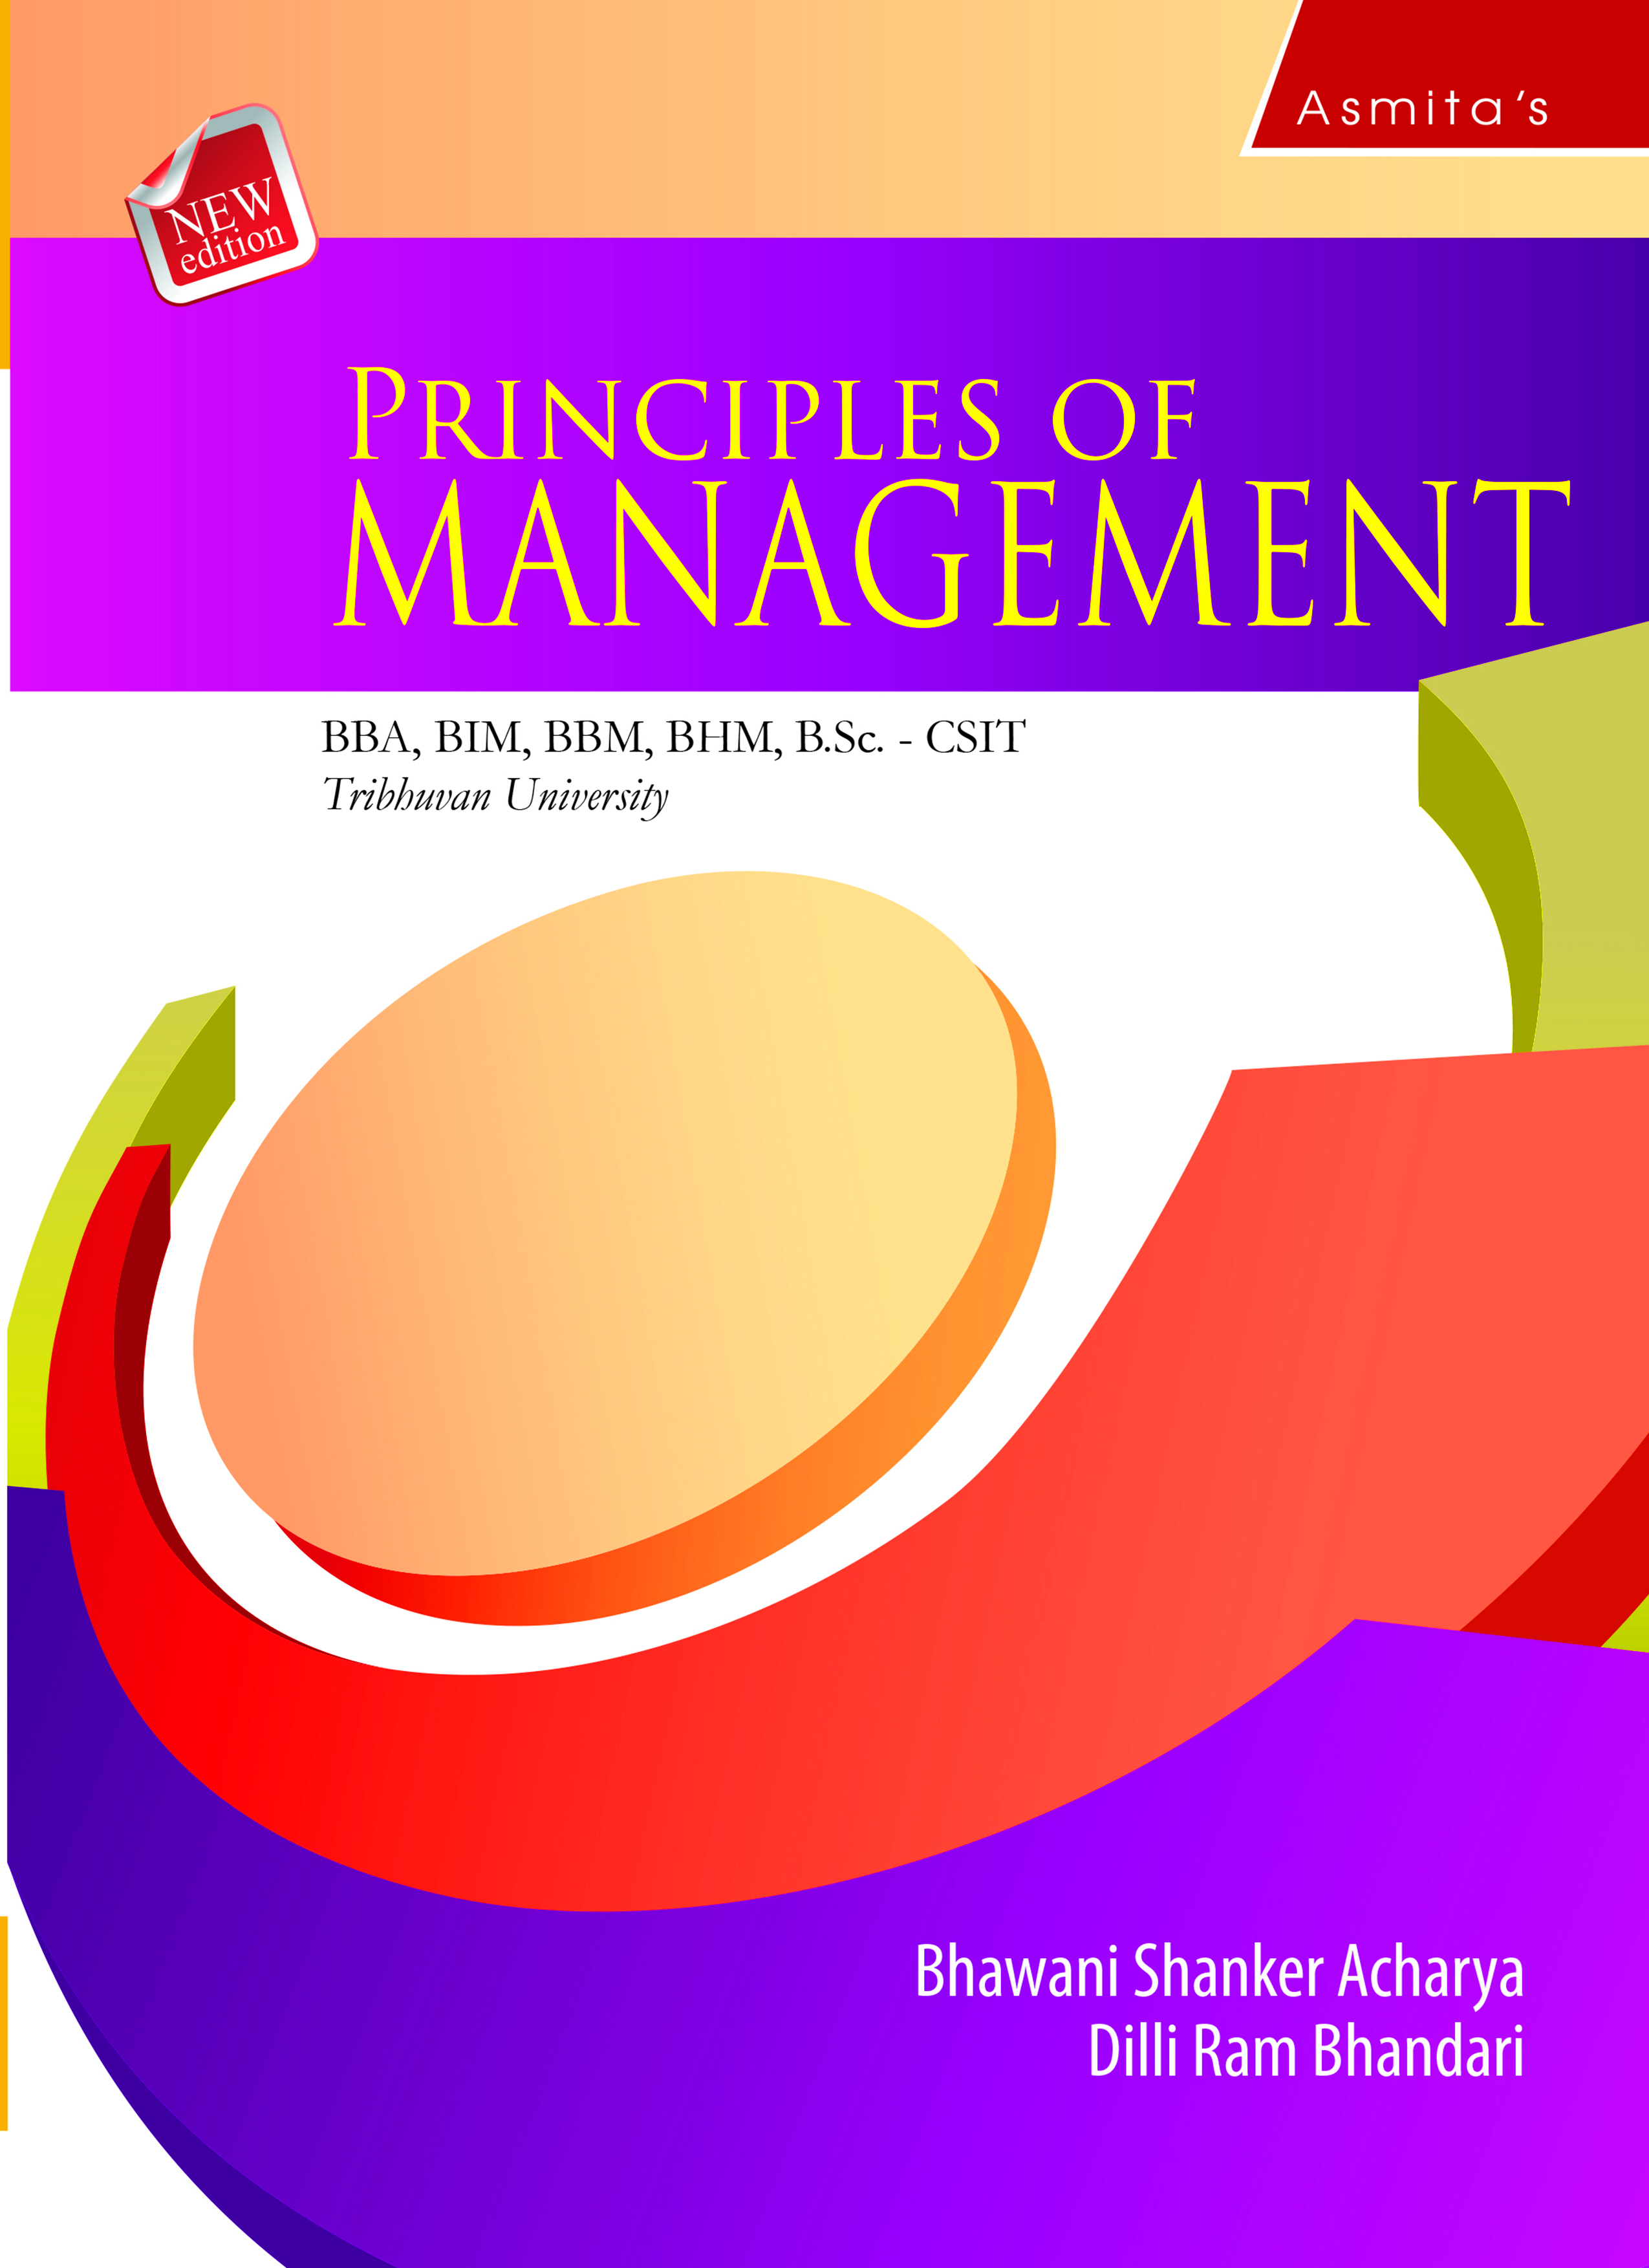
Controlling
Chapter 10

Slide 2
LEARNING OBJECTIVES
After studying this chapter, the students are expected to;
Understand the meaning, process, types, purpose, nature, essentials and tools and techniques of control
Know the potential barriers to successful controlling and overcoming them
Understand the concept, dimensions and objectives of quality
Explain the factors affecting quality
Know concept, principles and tools and techniques of quality management
Discuss quality improvement process
Understand the concept, principles and techniques of Deming management
Know the emerging issues in quality management
Understand production and operation management, supply chain management, kaizen six sigma, the Japanese 5s practice, technology management, management information system(MIS) and information technology.

Slide 3
Meaning/Concept of Control
Control is one of the important functions of management. It involves development of performance standards or indicators, measuring the actual performance and taking corrective actions, if any, deviation exists between the standard and actual performance. It is also called a performance evaluation.

Slide 4
Process/Steps of Control System
The process of control includes a number of interlinked activities.

Slide 5
Types of Control Systems
There are different types of controls based on focus of control and timing of control.

Slide 6
Purpose /Importance of Control System
The following are the importance or purpose of a control system.
1. Cope the environment 2. Accomplish organizational goals
3. Improve efficiency 4. Facilitate coordination.
5. Add value 6. Facilitate delegation
7. Maintain discipline 8. Guide future action
9. Effective supervision

Slide 7
Nature/Characteristics of Effective Control System
A control system has the following characteristics.
1. A management function
2. Continuous process
3. Plan/Guidelines oriented
4. Corrective action
5. An end function
6. Dynamic and pervasive function
7. Focus on key performance
8. Forward looking

Slide 8
Guidelines for Proper Control
There is no one ideal control system. It depends on the size, management style, purpose, problems, and strengths. The following are the some of the guidelines for proper control.
1. Economical
2. Timeliness
3. Provide true picture
4. Action oriented
5. Foster mutual understanding, trust, and common sense
6. Simple
7. Convincing

Slide 9
Essentials of Effective Control
The following are the some of the guidelines for proper control.
1. Economical 2. Timeliness
3. Provide true picture 4. Action oriented
5. Foster mutual understanding, trust, and common sense
6. Simple 7. Convincing
8. Objective 9. Flexible
10. Future oriented

Slide 10
Control Tools and Techniques
There are a number of tools and techniques used for control. Some major ones are discussed below.

Slide 11
Potential Barriers to Successful Controlling (Resistance of Control)
The following are some of the potential barriers to successful controlling.

Slide 12
Overcoming Resistance to Control
The following are the ways of overcoming resistance to control.
1. Create Effective Control System
2. Encourage Participation
3. Develop Verification Procedures
4. Change Employees’ Attitude
5. Take Action
6. Encourage check and balance mechanism
7. Use MBO

Slide 13
Overcoming Resistance to Control
There are different ways overcoming resistance to control. They are discussed below.
1. Create effective control system
2. Encourage participation
3. Develop verification procedures
4. Change employees’ attitude
5. Take action
6. Encourage check and balance mechanism
7. Education and communication

Slide 14
Concept of Quality
The quality control system is a set of procedures designed to ensure that a product or service matches the standard or benchmark quality criteria and meets the requirements of the customer. The word quality has many meanings. Quality in general may be defined as the standard of something as measured against other things of a similar kind. It is the degree of excellence of something. Hence, it is the ability of a product to satisfy the users.

Slide 15
Dimensions of Quality
Quality is a multidimensional concept. Hence, it has a number of facets which are presented in the following table.
 | Dimensions | Examples
1. Performance | How well the product performs in comparison to how it was designed to perform | Clarity of color and sound of Sony TV.
2. Features | What different functions or tasks can the product perform | Complementary breakfast of Hyatt Regency Hotel.
3. Reliability | Likelihood that the product will perform throughout its expected life | 1 year maintenance cost of Honda.
4. Conformances | Does the product meet its specifications as designed | Comparison of IBM software in Apple computers.

Slide 16
Dimensions of Quality …(contd)
 | Dimensions | Examples
5. Durability | The actual life expectancy of the product | Average age of Kribi Vacuum cleaner is 17 years.
6. Serviceability | What is the ease of fixing or repairing the product if it fails | Cartapilars Tractor guarantees replacement parts within 48 hours.
7. Aesthetics | The style, materials and visual appeal of a product | Taste of Robbins ice-cream and size of Baskin.
8. Perceived quality | Based on customer's experience before, during and after they purchase a product | Status of Bose in Stereo speaker.

Slide 17
Objectives/Importance of Quality
The following are the objectives/importance of quality:
1. Meet competition
2. Increase productivity
3. Increase reputation
4. Higher profitability and growth

Slide 18
Factors Affecting Quality
There are many factors that affect the quality of products.
1. Cost
2. Materials
3. Policy/Management support
4. People
5. Nature of market
6. Machines/methods and engineering design
7. Research and development budget
8. Information availability

Slide 19
Concept of Quality Management
In a simple way, quality management is managing the quality. Hence, it includes all activities carried to maintain a desired level of quality or excellence. Hence, it is a set of activities that are followed to ensure that the goods and services meet customers’ expectations and needs. In a competitive environment, the success of organizations largely depends on the quality of their products and services. Quality management is equally important for all organizations whether large or small, public or private, manufacturing or service.

Slide 20
Principles of Quality Management
Quality management is based on certain principles which are discussed below.

Slide 21
Concept of Total Quality Management
Total Quality Management (TQM) is a management approach that focuses on continuous quality improvement of products and services by using continuous feedback. The objective of TQM is doing things right the first time over and every time. It seeks to integrate all organizational functions to focus on meeting customer needs and organizational goals. Hence, TQM views an organization as a collection of processes. It ensures that every single employee is working towards the improvement of work culture, processes, services, and systems to ensure long-term organizational well being.

Slide 22
Principles/Components of TQM
TQM is based on the following principles/components.

Slide 23
Tools and Techniques of TQM
TQM is a managerial approach for continuous improvement of products and services. For this, it uses a number of tools and techniques. They are illustrated below.

Slide 24
1. Value Added Analysis
Increasing customer value is the primary objective of an organization. Value added analysis involves a comprehensive analysis of the all the organizational activities to determine the value they add to the customers. This helps to remove the wasteful and unnecessary activities without compromising on quality.

Slide 25
2. Benchmarking
Benchmarking is a continuous process of measuring products, services, and practices against the toughest competitors or the industry leaders. It involves openly learning from others to improve quality. Benchmarking may be done in many ways.

Slide 26
Outsourcing
Outsourcing is an organizational practice in which a company hires another company/individual to perform certain tasks, handle operations or provide services that had previously been done by the company itself. It is also called contracting out.

Slide 27
4. Speed: Reducing Cycle Time
Cycle time is the time needed for an organization to develop, make and distribute its products. If the organization reduces its cycle time, quality will increase. This is because the organization can serve the customers as and when they require.

Slide 28
5. ISO 9000:2000 and ISO 14000
Another important tool of TQM is ISO 9,000:2000 which refers to a set of standards published by the International Organization of Standardization (ISO) that provides quality assurance requirements and quality management guidance. The standards were revised and updated in 2000.

Slide 29
6. Statistical Quality Control
Another tool of TQM is the statistical quality control (SQM). It includes a number of statistical tools for quality control. Some of them are;
Descriptive statistics: It is description of quality characteristics and relationships.
Acceptance sampling: It is sampling finished goods to ensure the quality standards are met.
The process sampling: It is an evaluation of the products during production process.

Slide 30
7. Six Sigma
Six Sigma is a quality management tool used to help organizations improve current processes, products or services by identifying and eliminating defects. It was developed in 1980 for Motorola Company. Now a days, this is used by both manufacturing and service organizations. Implementing Six Sigma requires making corrections until the errors virtually disappear. Six Sigma (six standard deviation) is obtained when a firm produces only 3.4 mistakes per million.

Slide 31
Quality Improvement Process (In TQM)
Quality improvement is an ongoing process. It involves the sequential steps taken to improve quality of process, product and services.

Slide 32
Concept of Deming Management
Edwards Deming was an eminent scholar and teacher in American academia for more than half a century. His efforts led to the transformation of management that has profoundly impacted manufacturing and service organizations around the world.

Slide 33
Principles of Deming Management
There are four principles of Deming's quality management. They are illustrated below:

Slide 34
Deming’s Quality Management Techniques
Edwards Deming offered 14 key techniques for management to follow to significantly improve the effectiveness of a business or organization.

Slide 35
Production Management
Production is a function an organization that is concerned with the transformation of inputs into the required outputs (products) with desired quality. It is a value addition process. At each stage of the process, there is a value addition.
Production management may be defined as the process of planning, organizing, directing, coordinating and controlling the activities related to production. It is related to the management of those activities that transform inputs into products and services. Hence, it deals with inputs, transformations, and outputs. The main goal of production management is to add value on the outputs.

Slide 36
Operations Management
Operations management is managing the routine organizational activities to ensure that the organization is able to operate efficiently and effectively. Hence, it involves the planning, organizing and supervising the activities related to conversion of input into the output. Its main objective is to use the resources optimally. It aims to offer the required products and services to the customers in conformity with the production process and policies. Hence, operations management is the management of an organization’s productive resources or its production system.

Slide 37
Concept of Supply Chain Management
Supply chain management may be defined as the management of the flow of products and services. It includes all processes and activities that transform raw materials into final products and avail them to the ultimate customers. It involves the streamlining of a business's supply-side activities such as, product development, sourcing, production, logistics, and the information systems to coordinate these activities by making them efficient and economical as possible. The central idea behind this is to maximize customer value and gain a sustainable competitive advantage in the marketplace.

Slide 38
Importance of Supply Chain Management
The following are some of the importance of supply chain management.
1. Improve customer service
2. Decrease operating costs
3. Promote collaboration
4. Less investment

Slide 39
Concept of Kaizen
Kaizen is a Japanese term composed of Kai and Zen. Kai means change and Zen means for the better. Hence, Kaizen means change for the better or continuous improvement. It seeks to improve operations continuously with the involvement of all employees.
The concept of kaizen is based on five basic ideas: teamwork, personal discipline, improved morale, quality, and suggestions for improvement

Slide 40
Principles of Kaizen
The Kaizen is based certain principles (www.spica.com).
Discard conventional fixed ideas.
Think about how to do it, not why it cannot be done, make things happen.
Do not make excuses or try to justify the past, start by questioning current and best practices.
If something is wrong or you have made a mistake, correct it immediately.
Do not seek perfection, do it right away even if it’s 50% of the target.
Creativity before capital. Do not spend money on Kaizen, use your wisdom.
You develop wisdom when faced with hardship.
Ask ‘why’ five times to seek the root cause (the 5-whys method).
Seek the wisdom of many people rather than the knowledge of one.
Kaizen is endless, so never stop improving.

Slide 41
Advantages of Kaizen
The main advantages of implementing Kaizen are;
A better workplace with a safer working environment.
Improved employee engagement and retention.
Higher problem-solving skills and teamwork spirit.
Enhanced customer satisfaction and market competitiveness.
Minimization of waste.
Increased efficiency and productivity for organizational success.

Slide 42
Concept of Six Sigma
Six Sigma is a quality management tool used to help organizations improve current processes, products or services by identifying and eliminating defects. It was developed in 1980 for Motorola Company. Now a day, this is used by both manufacturing and service organizations. Implementing Six Sigma requires making corrections until the errors virtually disappear. Six Sigma (six standard deviation) is obtained when a firm produces only 3.4 mistakes per million.

Slide 43
Features of Six Sigma
The following are some of the major features of the Six Sigma philosophy.

Slide 44
Methodologies
There are two major methodologies used in Six Sigma.
DMAIC (Define, Measure, Analyze, Improve and Control)
It is used mainly for improving existing business processes.
Define
Measure
Analyze
Improve
Control

Slide 45
DMADV (Define, Measurement, Analysis, Design, Verify)
This method is used to create new processes, products or services.
Define
Measurement
Analysis
Design
Verify

Slide 46
The Japanese 5S Practice
The Japanese 5S practices of quality management include the following five components.

Slide 47
Concept of Technology
The technology involves the practical aspects of science. Hence, it is a broader concept. It may take the form of tools, materials and systems. It translates the scientific knowledge into method of production. Hence, it refers to the ways to convert the organizational inputs into output.

Slide 48
Advantages of Technology
The following are the advantages of technology for organizations.

Slide 49
Management of Technology
Technology management may be defined as the science and art of getting people and technologies working together. It is an integrated planning, design, optimization, operation and control of technological products, processes and services. When the technology is managed properly, it allows the organizations to achieve effectiveness and competitive advantage.

Slide 50
Concept of Management Information System (MIS)
An MIS is a process which gathers data and information from multiple systems, organizes, analyzes, interprets, and reports them to the management for decision-making. Hence, the purpose of an MIS is improved decision-making, by providing up-to-date, reliable and valid data on a variety of organizational issues and problems. For this, it uses information technology, people, and business processes. MIS derives insights from the data that are critical for organization growth and sustainability. MIS is often connected with the computer system. Let’s consider the following definitions of MIS (www.geektonight.com).

Slide 51
Benefits of MIS
The following are some of the benefits of having an MIS system.

Slide 52
Components of MIS
The major components of a typical MIS are discussed below.

Slide 53
Concept of Information Technology
Information technology is a process of collection, storage, curation, dissemination, archiving and destruction of documents, images, drawings and others sources of information especially by using computers and telecommunications. Hence, it is the process by which relevant information is provided to decision-makers in a timely manner.
The "Harvard Business Review" has coined the term IT. It is the combination of technology to manage information efficiently and effectively.

Slide 54
Importance of Information Technology
The importance of information technology may be highlighted through the following points.
The proper use of information technology provides relevant, valid and timely information for the purpose of planning.
An information technology system provides the data to identify non-effective areas and leads to better business productivity and efficiency.
It provides relevant information for decision making.
It enhances communication inside as well as outside the organizations.
It facilitates better knowledge of customer needs.

Slide 55
Thank you

